Slide 1
Identification of Fire-Retardant Chemical Treatments via Instrumental Analysis
Caitlin Dillon
College of Arts and Sciences
Embry-Riddle Aeronautical University

Slide 2
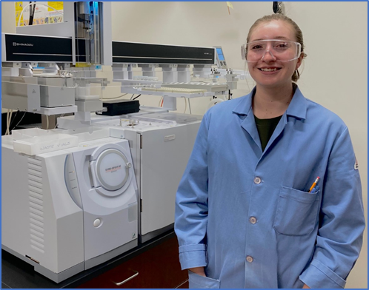
Background
Fiber trace evidence is one of the most common forms of evidence found at a crime scene
Evidentiary fibers often have unique flame retardant compounds that can be used to differentiate fibers
Development of an instrumental analysis method to identify fiber manufacturers
Forensic method would help to identify individuals from fiber trace evidence and assist in environmental forensic investigations
Caitlin Dillon in front of GCMS.

Slide 3
Objective
Create a method that forensic investigators can use to determine the origin of fibers using fire-retardant chemical residues.
Determine if there is enough chemical variation between fiber samples for identification

Slide 4
Method
Test various carpet fiber samples from different manufacturers with a range of carpet qualities and fiber types
Fiber samples have been tested using Fourier- transformation infrared spectroscopy (FTIR) and scanning electron microscopy with energy dispersive x-ray spectroscopy (SEM/EDS)
Fiber samples have undergone testing using gas chromatography mass spectrometry (GC/MS) using solid-phase microextraction

Slide 5
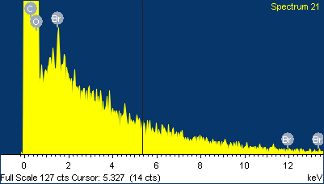
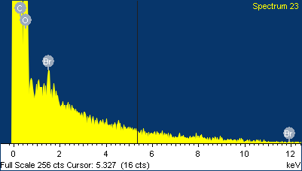
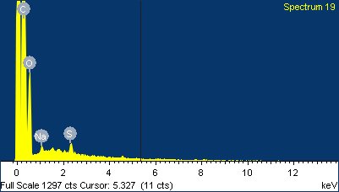
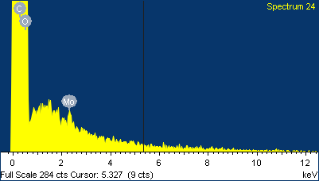
Results
Element | Weight | Atomic %
C | 65.74 | 71.96
O | 34.09 | 28.01
Br | 0.17 | 0.03
Element | Weight | Atomic %
C | 61.60 | 68.21
O | 38.21 | 31.76
Br | 0.19 | 0.03
Figure 1 SEM data from sample DDP
Figure 3 SEM data from sample HHP
Element | Weight | Atomic %
C | 77.78 | 82.50
O | 21.62 | 17.22
Na | 0.31 | 0.17
S | 0.29 | 0.12
Element | Weight | Atomic %
C | 75.63 | 80.69
O | 24.06 | 19.27
Mo | 0.30 | 0.04
Figure 2 SEM data from sample DDN
Figure 4 SEM data from sample HHN

Slide 6
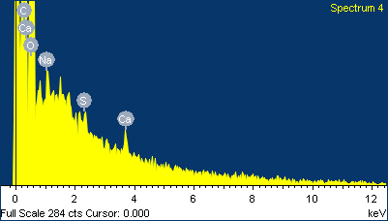
Results
Element | Weight | Atomic %
C | 60.77 | 67.40
O | 39.05 | 32.52
Na | 0.09 | 0.05
S | 0.04 | 0.02
Ca | 0.05 | 0.02
Element | Weight | Atomic %
C | 61.23 | 67.80
O | 38.68 | 32.16
Al | 0.09 | 0.04
Figure 5 SEM data from sample RSP
Figure 6 SEM data from sample RSPET
Scanning electron microscopy used with dispersive x-ray spectroscopy determined that there are fire-retardant chemicals present in samples
Gas chromatography mass spectrometry using solid phase microextraction and Fourier-transform infrared spectroscopy testing require more method development

Slide 7
Conclusion
Scanning electron microscopy with energy dispersive x-ray spectroscopy determined that fire retardant residue is present on sample fibers
Results from gas chromatography mass spectrometry testing using solid phase microextraction support the hypothesis that melt spinning process was used to apply fire-retardant compounds and manufacturers are moving toward applying nonvolatile chemicals on textiles
During development of liquid extraction method efficiency, sensitivity, and nondestructive analysis techniques are prioritized

Slide 8
Future Research
Continue to test instrumental analysis method using GC/MS with SPME
Develop liquid extraction procedure of fire-retardant chemicals from fibers
Collect more samples of various quality to test with instrumental analysis methods

Slide 9
Acknowledgements
Mentor; Rachael Schmidt
Dr. Hillary Eaton
Chemistry Department Facilities
Dani Carmack
Zapata, F., et al. (2022). Spectrochimica Acta Part A:Molecular and Biomolecular Spectroscopy,268, 120695.https://doi.org/10.1016/j.saa.2021.120695
Grover, T., et al. (2014). Colourage,61, 39-45+48
Alvarez, D. A., et al. (2021). Environmental Toxicology and Chemistry,40(8), 2165–2182.https://doi.org/10.1002/etc.5118
Horn, G. P., et al. (2021). Journal of Occupational and Environmental Hygiene,0(0), 1–15.https://doi.org/10.1080/15459624.2021.2002343

